Slide 1



Digital Transformation through Life moment analytics
Barclaycard 50 years young
Presented by:
DATA SCIENCE PEOPLE

Slide 2
Agenda
Overview and concept solution
Conceptual architecture and Minimal Viable Product demo
Product roadmap
Q&A

Slide 3
Key steps
Build loyalty and positive customer sentiment
Emphasize win-win proposition; offer special benefits as well as increase revenue, cross sell, upsell or no sell
Future product roadmap

Slide 4











Conceptual Architecture – Life Moments Digital Marketing Platform
JSON
JSON
Consumer
Processing Engine Server
Engine
Streaming Social Media Feeds
Campaign Success Probability Calculator
Campaign initiation
JSON
Keyword File
Predictive Model Deployment
Tokenization
Sentence Segmentation
Named Entity Extraction
Other Text Processing Services
Retrieve Card holder data from SFDC
Historical Campaign Data

Slide 5
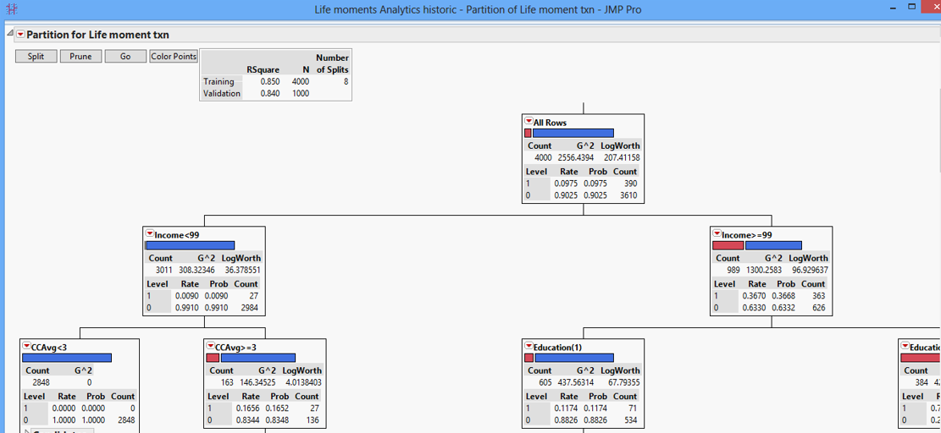
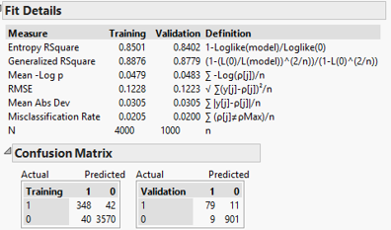
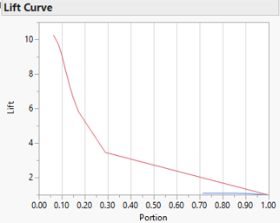
Analytics Model Summary

Slide 6
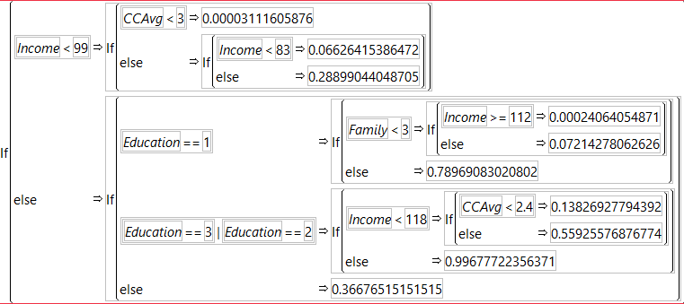
Probability calculation from Decision tree

Slide 7
Future vision
Customer segmentation on event, demography(age, income, gender, location) and future revenue strategy
Identify possible future important milestone from a life event and improve campaign strategy
Tie up with merchants to get line item details and get in-sight of customer taste by demography and build marketing strategy
Technology and architecture review to cope up with market trend and a sustainable product life

Slide 8
Questions?
Thank you

